Slide 1
DSC 530 Final
How much does study time affect exam performance?
By: Alex Hamedaninia

Slide 2
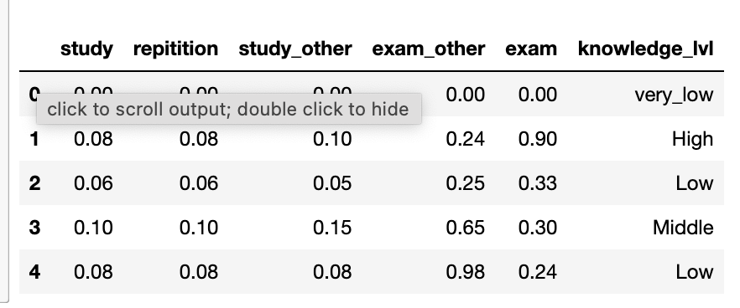
The dataset and the variables
This dataset was obtained from Kaggle here: https://www.kaggle.com/datasets/ruchi798/analyzing-screen-time?sort=published
The variables we will be used are:
Study - the degree of time spent studying
Repetition - the degree of repetition during studying
Study_other - the degree of time spent studying for other classes
Exam - the degree of performance on the exam
Exam_other - the degree of performance on other exams
Knowledge_lvl - the level of knowledge on the subject.

Slide 3
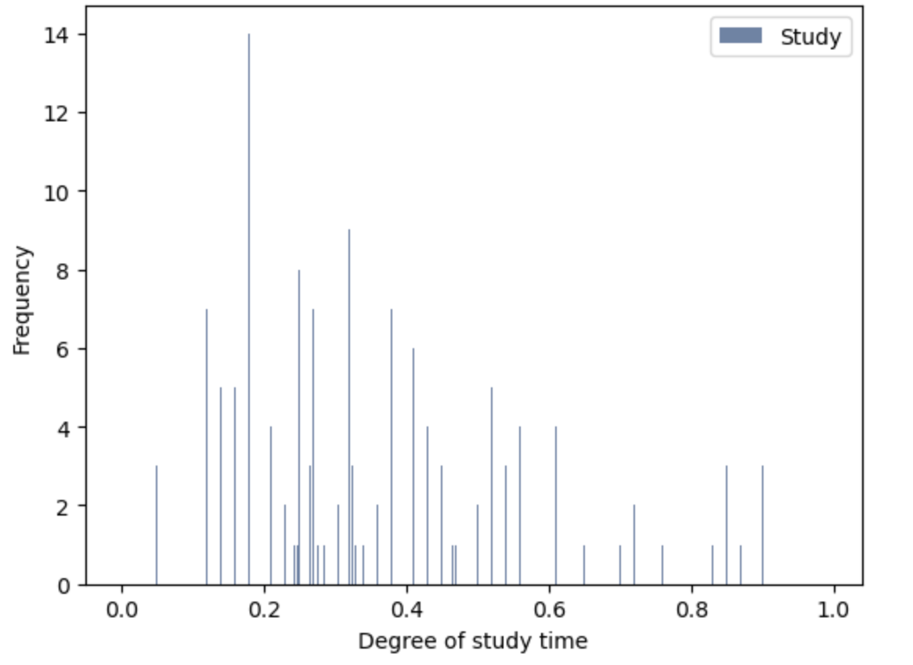
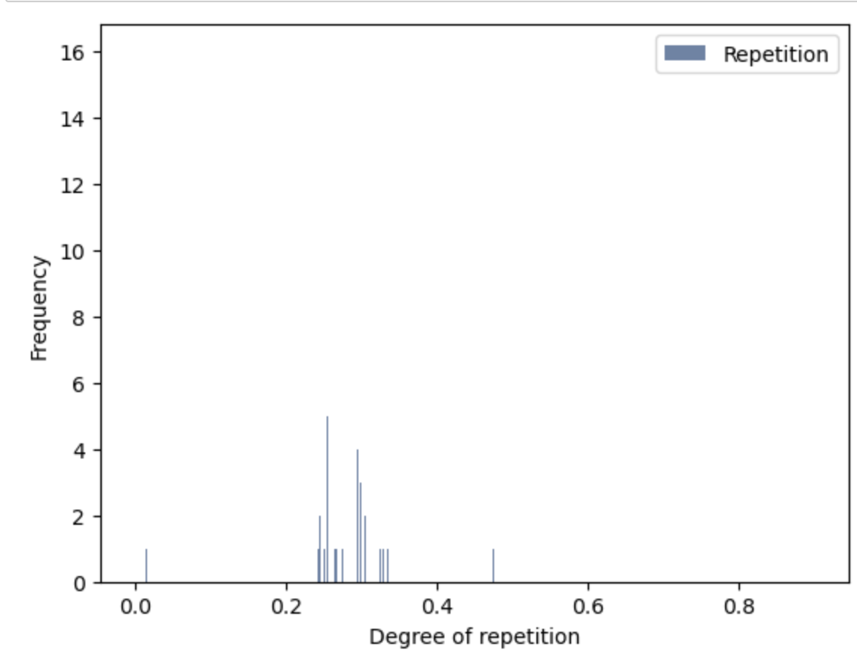
Histograms
We have a normal distribution here that is slightly skewed to the left. No visible outliers.
It looks like we may have two outliers here at 0.5 and 0.01, but let's take a look at the rest of the data to see if they show up anywhere else. Otherwise, it is a roughly normal distribution.

Slide 4
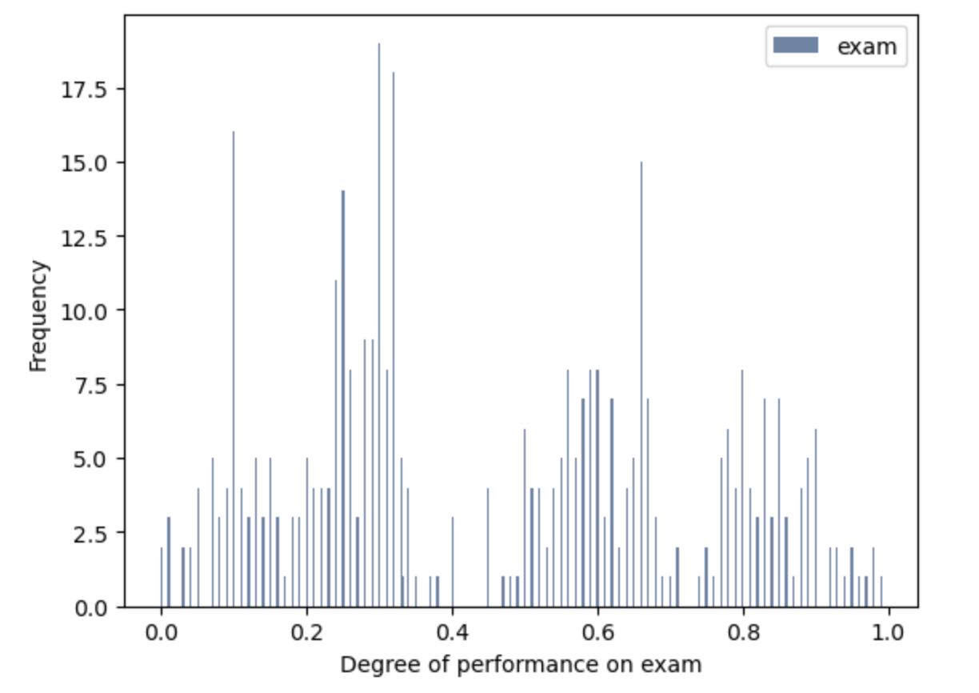
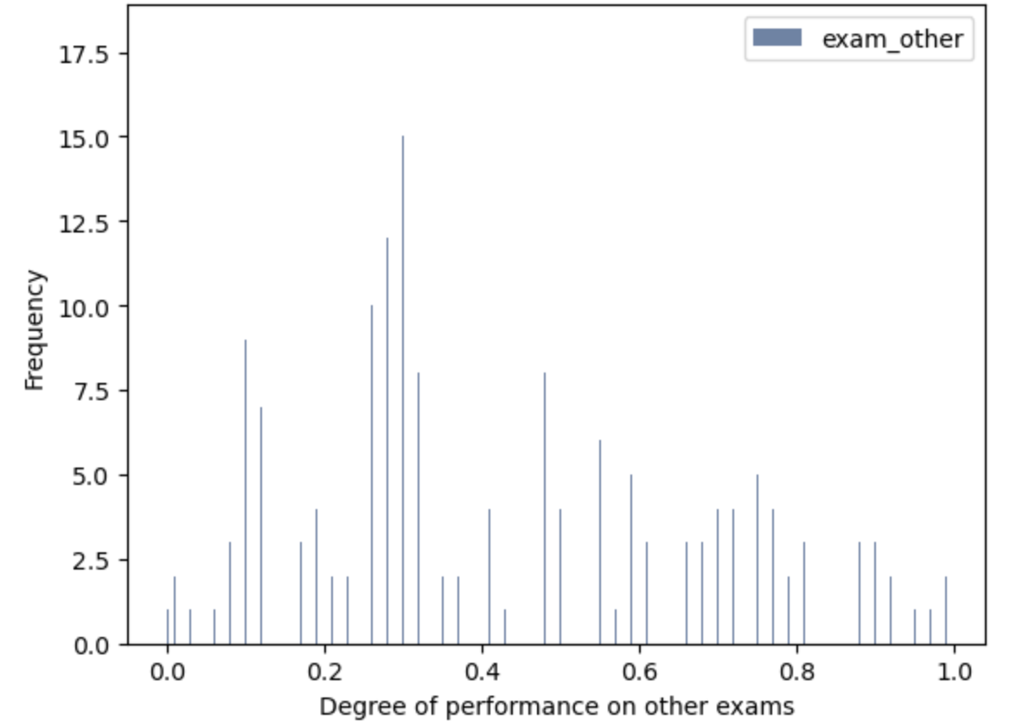
More histograms!
In terms of performance, we have a roughly binomial distribution here as well. We can see most students did either really well, roughly 60%, or failed badly. No visible outliers.
We have a roughly normal distribution here as well, with no visible outliers.

Slide 5
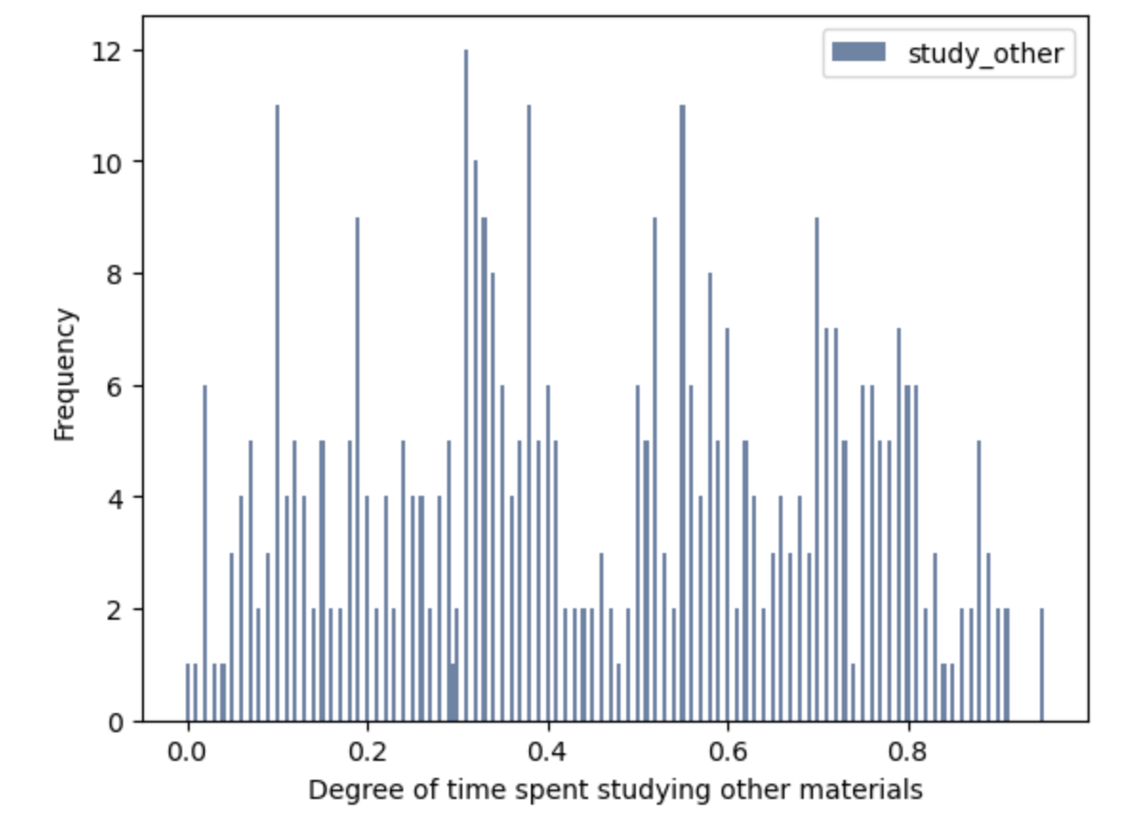
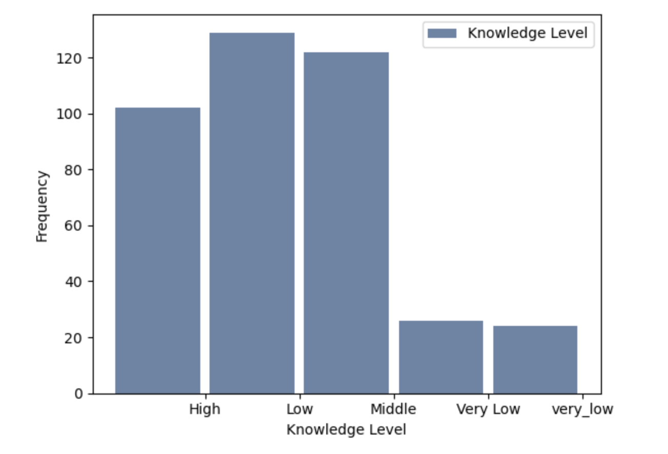
More histograms!
We can see that the knowledge level has a normal distribution, with most students having low knowledge, the other half being middle/high. This is pretty consistent with our exam scores as well.
In this distribution, we have a really solid spread of data points here. Specifically, we seem to have a binomial distribution, but we have no visible outliers.

Slide 6
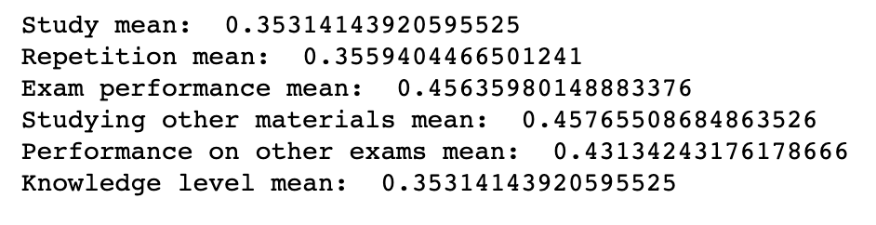
Descriptive characteristic - Mean
We can see that most of these scores are way below average. We can investigate the implications of this by taking a look at the mode to see if it's outliers messing up the data, or if it's just how the spread is.

Slide 7
Descriptive characteristic - Mode
Study - 0.20
Repetition - 0.29
Exam performance - 0.3
Studying other materials - 0.31
Performance on other exams - 0.29
Knowledge level - 0.1, 0.18, 0.20
This seems pretty consistent with our values from the mean. We can safely say there are no outliers skewing our results. Let's continue on and find the spread of our values, also known as the variance.

Slide 8
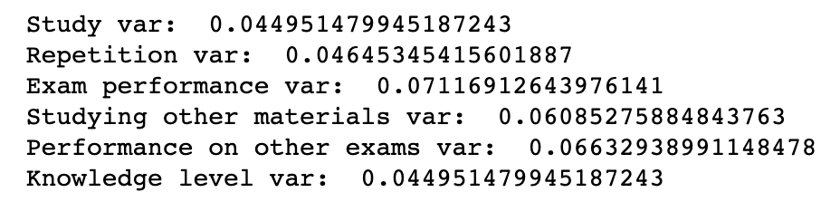
Descriptive characteristic - Spread (variance)
These values are all decently low, which means we should expect our means to deviate by each of these values to their corresponding variables.
This implies our data is predictable and consistent to our mean.

Slide 9
Descriptive characteristic - Tails
To get the tail of each variable, we can take find the 5th and 95th percentile to see what our high and low values are.
Study: (.08, .779)
Repetition: (.081, .89)
Exam: (.07, .83)
Studying for other exams: (.07, .83)
Performance on other exams: (.09, .88)
Knowledge: no tails really exist for this variable
Our tails show to be consistent with our values, and have a wide spread consistent with our histograms.

Slide 10
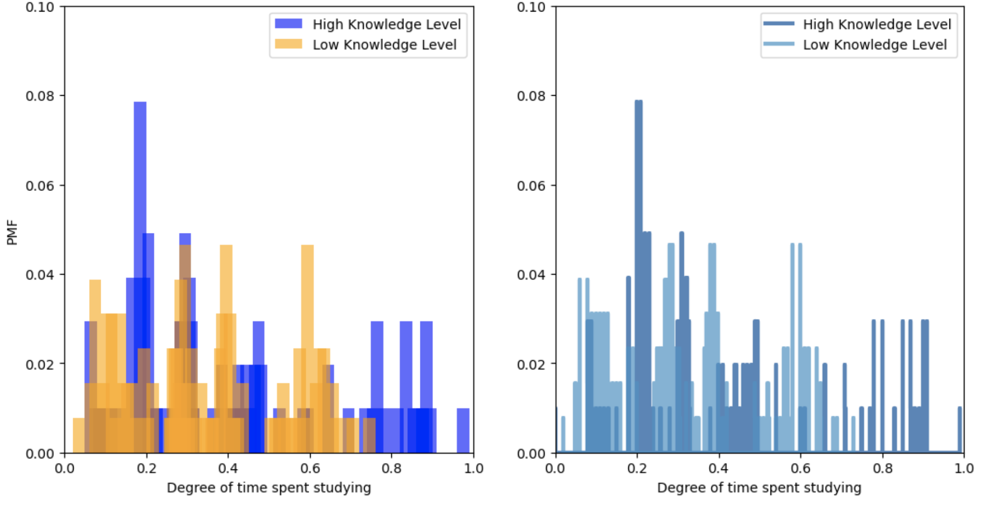
Compare scenarios using PMF
We can see that most people with a lower knowledge level would study to a degree from nothing to the higher end of 0.8, or in the 80th percentile of the class in terms of study time.
However, it's interesting to see that a majority of those with a high knowledge level spent little time studying, an average amount time studying, or the most time spent studying.

Slide 11
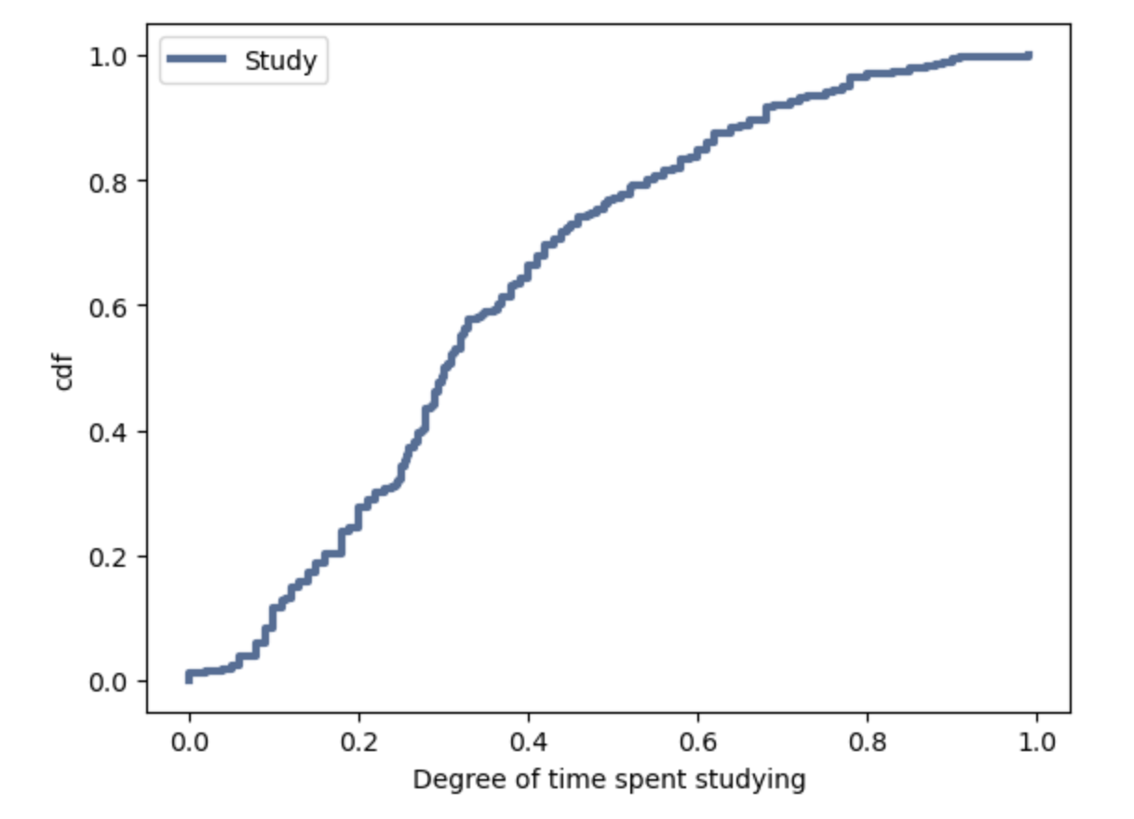
CDF of study variable
Our cdf here almost appears linear, meaning most of our values are normally distributed, with more values coming in at 0.3, as that is where our curve is the steepest. This tells us that most students spend a variable amount of time studying. Let's compare this with a cdf of the exam performance.

Slide 12
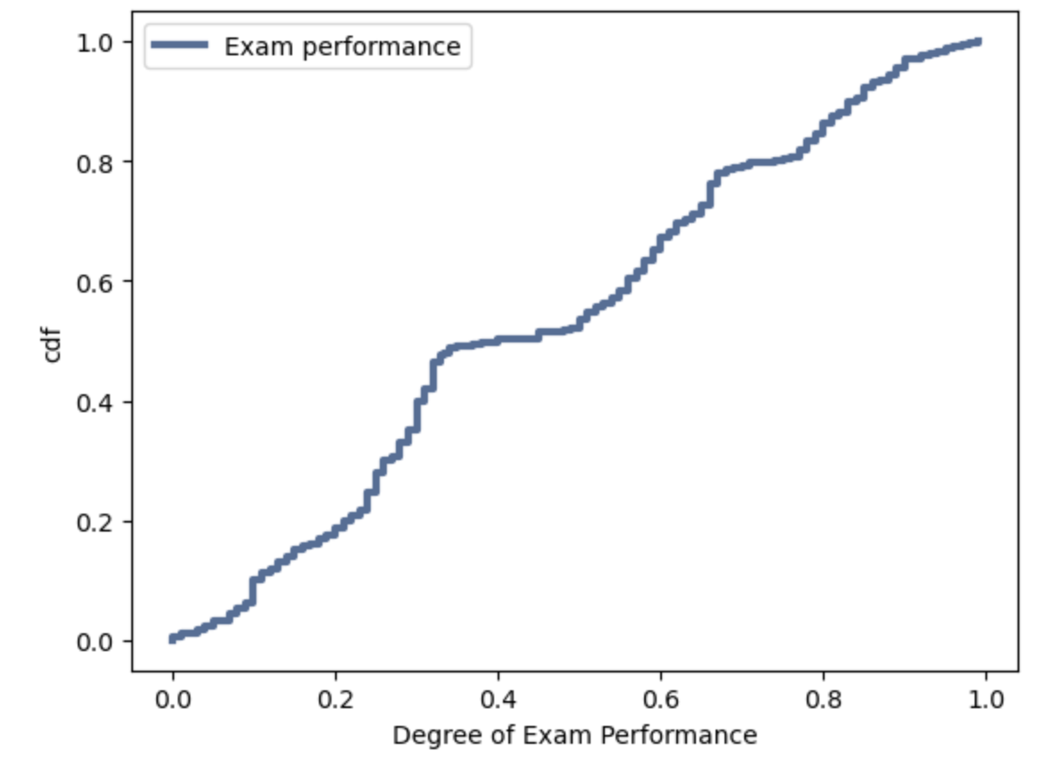
CDF of exam performance
This pmf coincides with the study time pretty well, and it shows that our performance is very linear with values very normally distributed, since our line is roughly straight, other than a few bumps at 0.4 and 0.8.

Slide 13
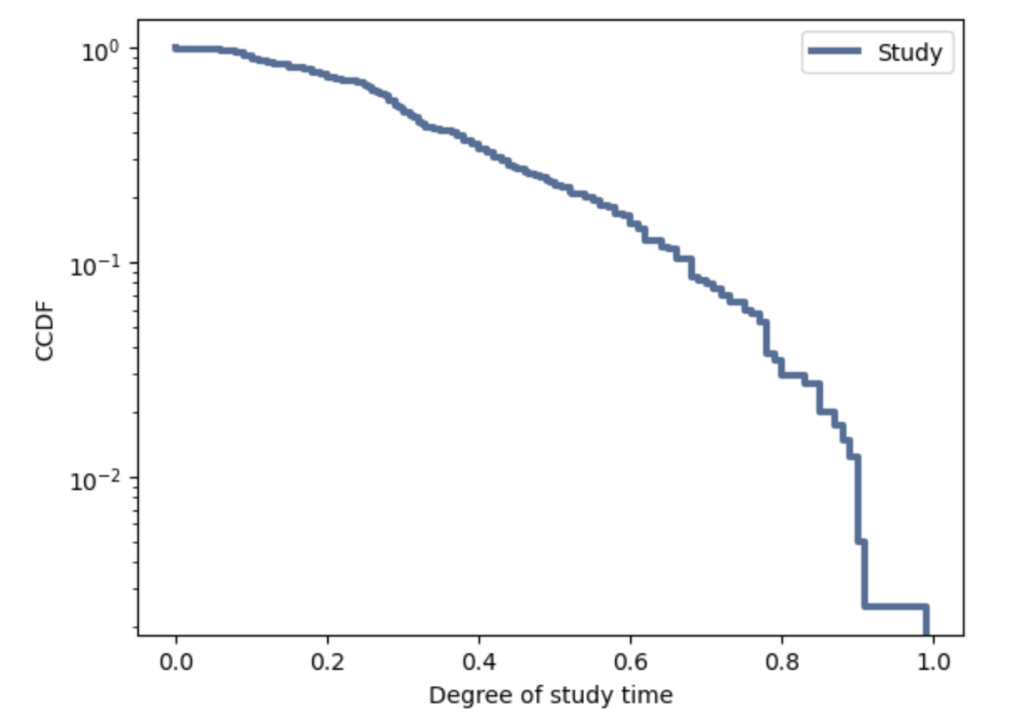
Analytical distribution - exponential
It's not exactly straight, which indicates that an exponential distribution is not a perfect model for this data. It indicates that our underlying assumption -- more time spent studying equates to better exam performance -- isn't necessarily true, but it is still reasonable to model this dataset with an exponential distribution.

Slide 14
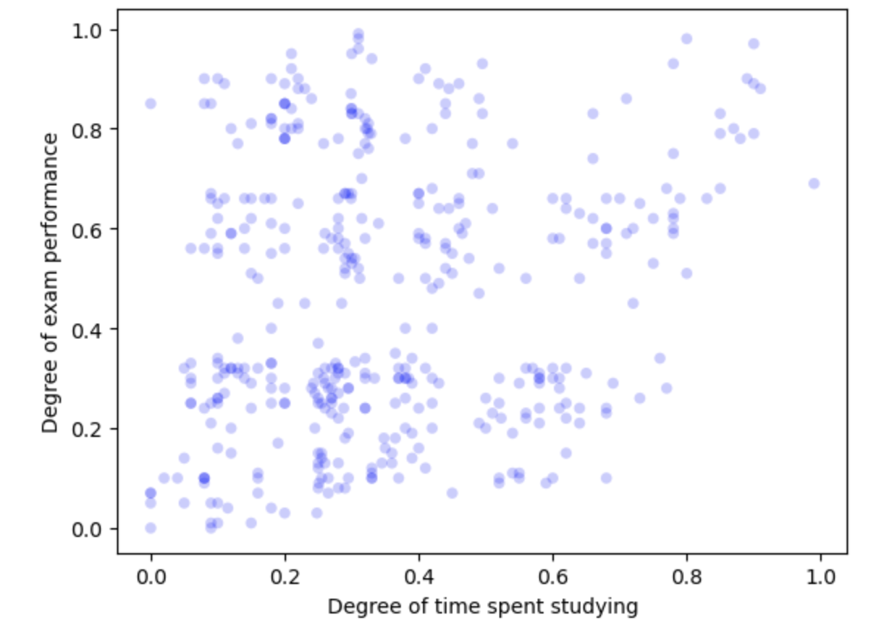
Scatter plots - exam performance and study time
Shockingly, there is no real correlation to be seen here. Let's now compare our two exam performances. This indicates there is not much of a correlation between amount of time spent studying and exam performance. There may be some other factors that may be able to tell us more.

Slide 15
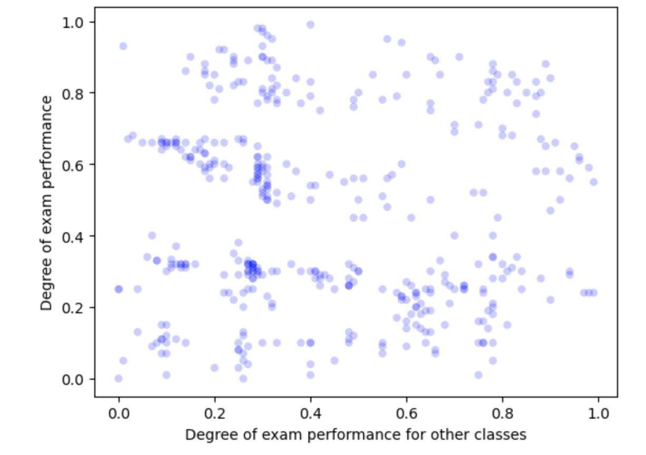
Scatter plots - exam performances
We can see there are some clusters, but not much of a correlation. Similar to the last one, this indicates there is not a strong relationship between the performance of one exam and the other exam performance. We can dive a little further into this coming up.

Slide 16
Covariance
The covariance of study time and exam performance: 0.01120680767075716
The covariance of the two exam performances: -0.0026923093116760772
As we have a positive covariance for study time and exam performance, this indicates as more time is spent studying, the better the exam performance will be. Interestingly though, as we have a (albeit very small) negative covariance for the two exam performance, this indicates that as students do better on one exam, they do worse on the other.

Slide 17
Correlation
The correlation of study time and exam performance: 0.1986292015696653
The correlation of the two exam performances: -0.03928304345341544
There's about a 20% correlation between study time and performance, further confirming that as students spend more time studying, their performance will go up. The same applies to the two exam performances -- as students do better on one exam, their grades will be slightly lower on the other exam.

Slide 18
Spearman’s correlation
The Spearman correlation of study time and exam performance: 0.1718850201850126
The Spearman correlation of the two exam performances: -0.053452971830440385
As these values are slightly different, this indicates that these relationships are not perfectly linear. However, since the difference was small, we can say it still generally follows a similar trend. In both cases, the Spearman correlation might be slightly lower because it considers monotonic relationships in addition to linear ones.

Slide 19
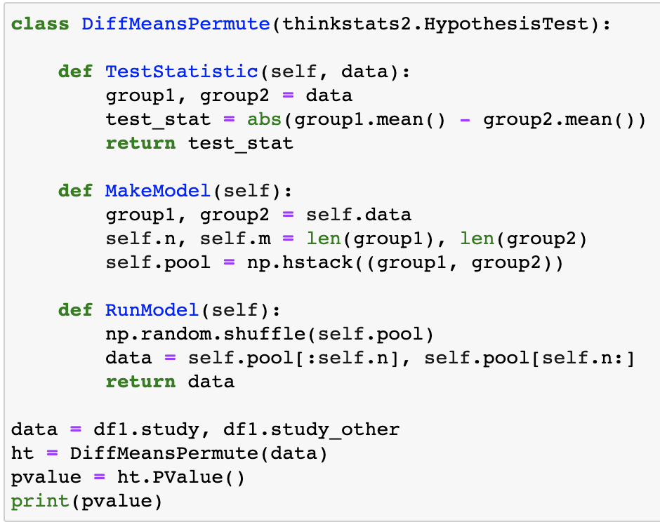
Hypothesis testing - Difference in means
After conducting the difference of means hypothesis test on our two study variables, study and study_other, we received our p-value of 0.
This indicates statistical significance, indicating our hypothesis that these two have a low difference in means holds true.

Slide 20
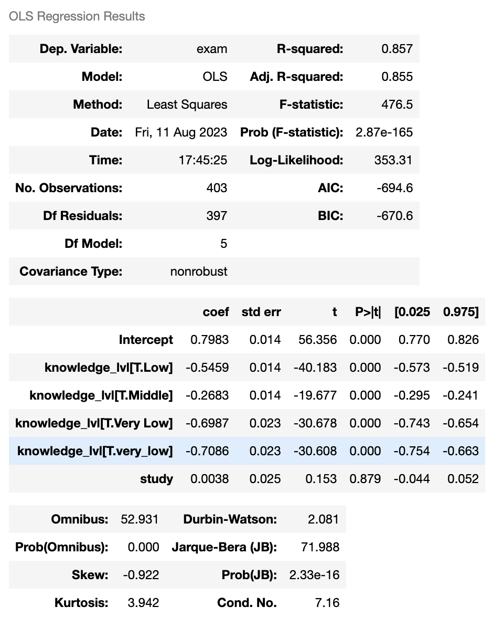
Regression Analysis
We can see that knowledge level and study time make up for 85% of the variability of a student's exam score according to the R-squared statistic. Our p-values are also all low, except for study time which is incredibly high. Thus, for we can say knowledge level is very statistically significant, whereas study time is not as significant.

Slide 21
Conclusion
We have learned quite a lot about this data set, and it brings us back to our original question -- how much of an effect does study time have on performance?
We saw that the correlation between just studying and exam performance was decently low. We also saw that once knowledge level was introduced, the variation jumped to 85% variability in the last regression model, from our R-squared statistic. Also, in our comparison, the students who studied the most had the highest knowledge level, though there were a few who had high knowledge who didn’t study much at all.
This goes to say that studying more may lead to increasing knowledge level, and this could increase exam performance. More investigations could go further to refine the model to more accurately predict a student’s exam performance based off of other characteristics.

